Slide 1
NCA Sponsored Training
Day 2 – Morning Session (Theory)
Password Cracking
Presenter Name: Dr. Danish Vasan
City: Dhahran
15 February 2025
Notes:
Sanjay Goel - University at Albany
Purdue

Slide 2
Outline
Introduction to Password
What is a Password
Password Management
Common Attacks
Hash Functions
Introduction
Hash Function for Password Storage
Hash Functions for Secure Password Storage

Slide 3

Passwords
What is a password ?
It is an arbitrary long sequence of characters
It should be secret
It should be difficult to guess

Slide 4
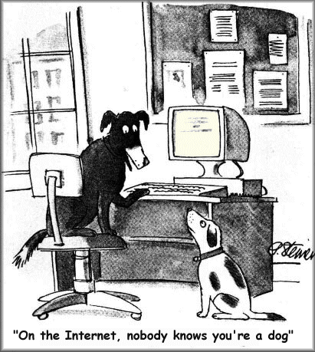
Passwords
Basic Problem
How do you prove to someone that you are who you claim to be?
Any system with access control must solve this problem

Slide 5

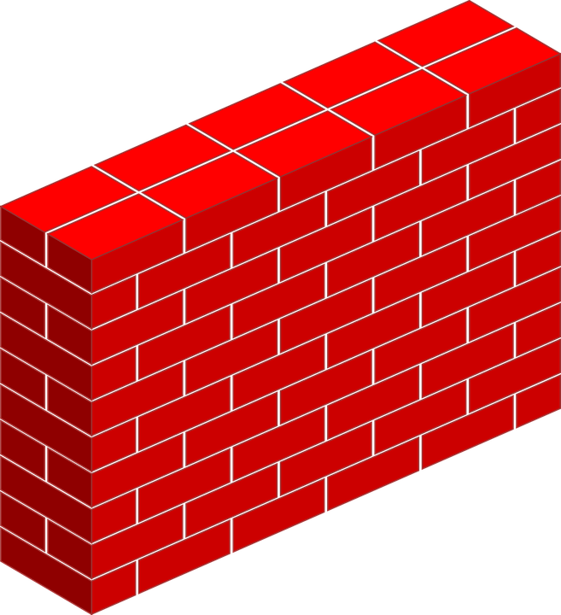


Passwords
Why we need passwords ?

Slide 6

Passwords
Authentication
User has a secret password.
System checks it to authenticate the user.
Vulnerable to eavesdropping when password is communicated from user to system

Slide 7
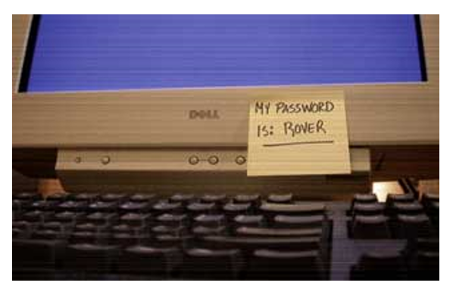
Passwords
Basic Security problems
How easy is it to guess the password?
How is the password stored?
How does the system check the password?

Slide 8
Passwords – Guess Difficulty
How easy is it to guess the password?
A lock constituted by three cylinders... only digits!
In order to open it, you need to find the right sequence
What if you do not know it ?
The three digits sequence opening the lock
should be chosen among 10 x 10 x 10 = 1000
One out of 1000 !
X
Y
Z
0
1
2
3
4
5
6
7
8
9
0
1
2
3
4
5
6
7
8
9
0
1
2
3
4
5
6
7
8
9

Slide 9

Passwords – Guess Difficulty
Pick Me! I’ll do it
Let’s try to break a key of 6 digits …

Slide 10
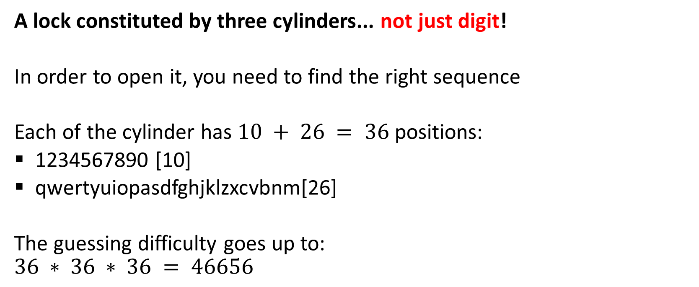
Passwords – Guess Difficulty
A lock constituted by three cylinders... not just digit!
In order to open it, you need to find the right sequence
Each of the cylinder has $10 + 26 = 36$ positions:
1234567890 [10]
qwertyuiopasdfghjklzxcvbnm[26]
The guessing difficulty goes up to:
$$36 ∗ 36 ∗ 36 = 46656$$
X
Y
Z

Slide 11
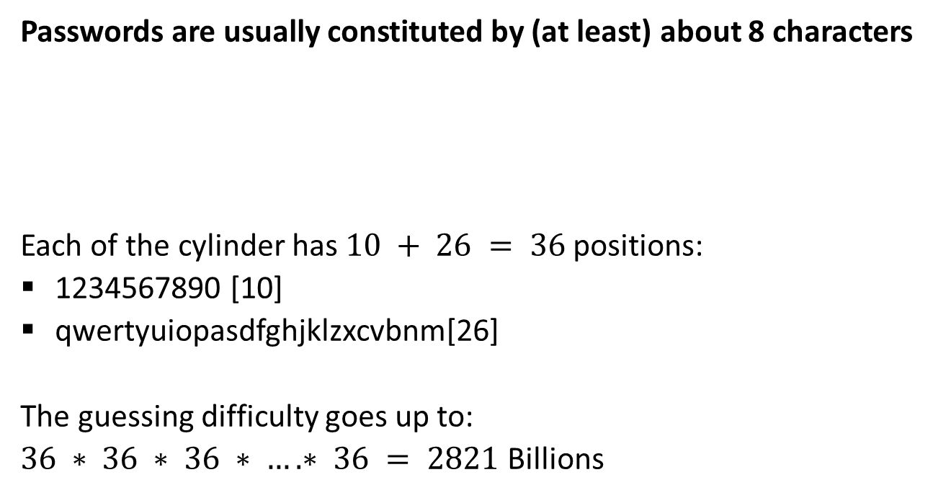
Passwords – Guess Difficulty
Passwords are usually constituted by (at least) about 8 characters
Each of the cylinder has $10 + 26 = 36$ positions:
1234567890 [10]
qwertyuiopasdfghjklzxcvbnm[26]
The guessing difficulty goes up to:
$36 ∗ 36 ∗ 36 ∗ …. ∗ 36 = 2821$Billions
X₁
X₂
X₃
X₈
……………..
Is this enough ?

Slide 12

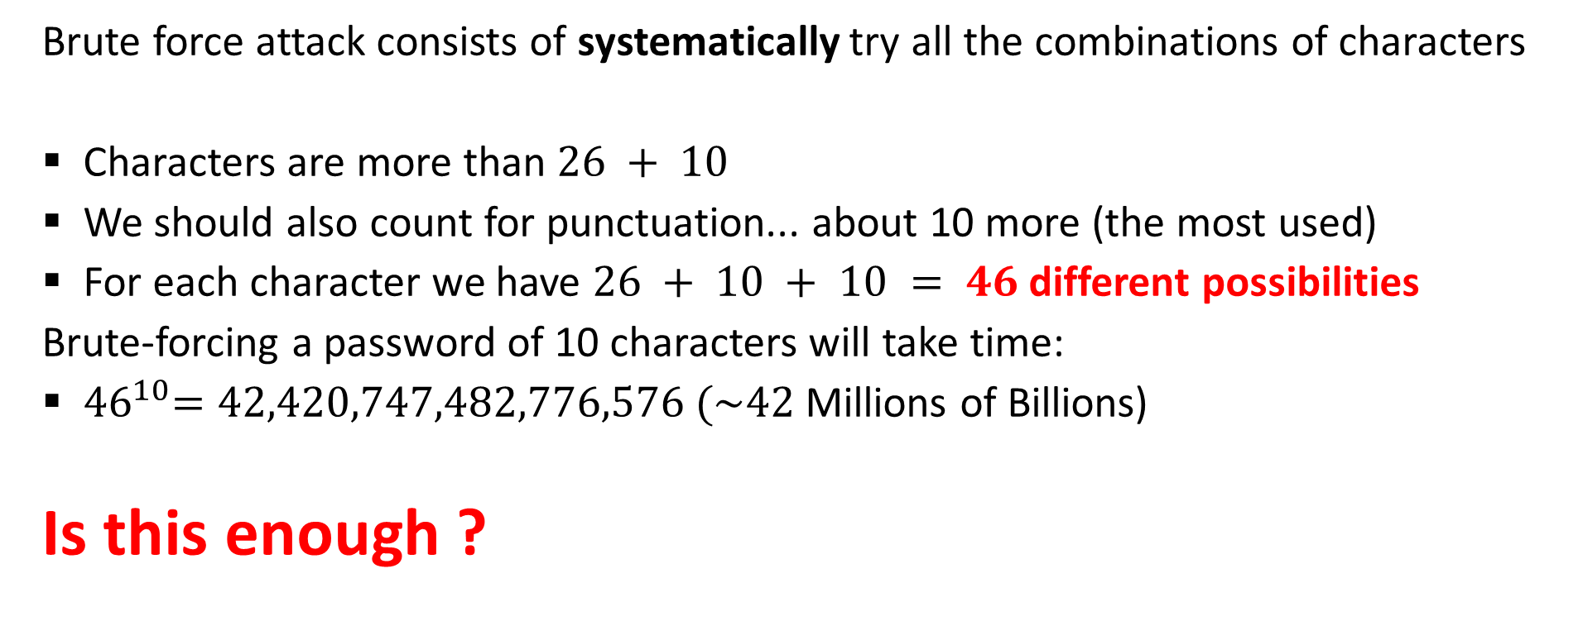
Passwords – Brute Force Attack
Brute force attack consists of systematically try all the combinations of characters
Characters are more than $26 + 10$
We should also count for punctuation... about 10 more (the most used)
For each character we have $26 + 10 + 10 = 46$different possibilities
Brute-forcing a password of 10 characters will take time:
${ 46}^{10}=42,420,747,482,776,576 (\sim 42$Millions of Billions)
Is this enough ?

Slide 13
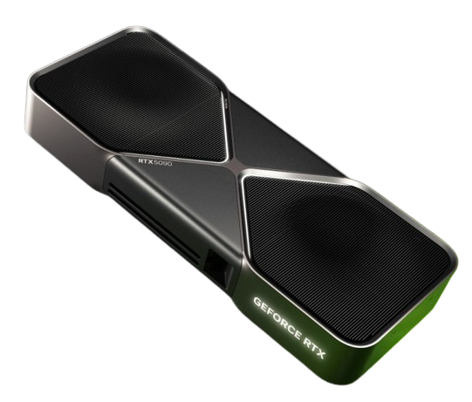
Brute Force
Nvidia’s new RTX 5090 graphics card is powerful enough to break password-cracking records, according to benchmarks by a password recovery firm.
Tested against:
Microsoft’s New Technology LAN Manager (NTLM) authentication protocol: 330GH/sec
Bcrypt: 255KH/sec
KH/s (kilo): Thousand hashes per second
GH/s (giga): Billion hashes per second
Notes:
https://www.itpro.com/hardware/components/369322/nvidias-rtx-4090-is-a-powerful-password-cracking-tool

Slide 14
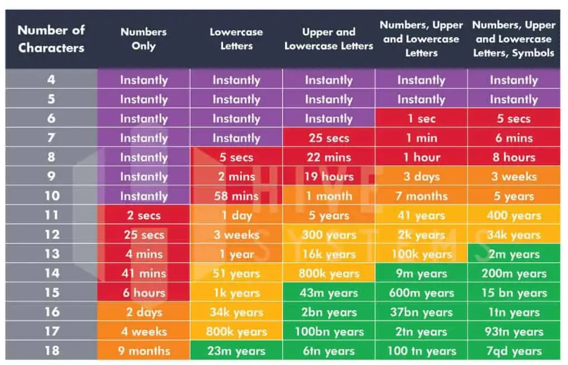
Passwords – How Secure is your Password?

Slide 15
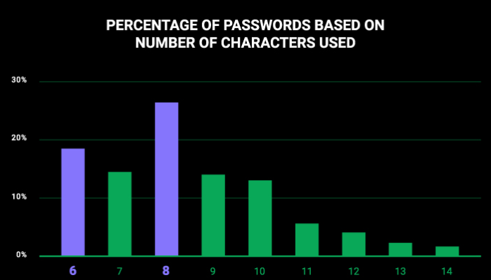
Passwords – How Secure is your Password?
Notes:
https://cybernews.com/best-password-managers/most-common-passwords/

Slide 16

Password Strength
First issue: How do you chose your password?
Passwords are never chosen like the following:
j39dh5ks
d93kdh3a
k30fj50d
The above are 8 random characters passwords.
Your passwords do not look like the above ones, right ?

Slide 17

Password Strength
Usually, passwords contain:
Personal information (names/surnames, phone numbers, birthdate, etc.)
Sport teams and sport terms
Cities
Months, weekdays, seasons
Food
Keyboard pattern
This habit significantly decreases the difficulty to guess your passwords
... and the bad guy will be very happy !!!

Slide 18

Top 20 most common passwords of 2024
123456
Admin
12345678
123456789
1234
12345
Password
123
Aa123456
1234567890
UNKNOWN
1234567
123123
111111
Password
12345678910
000000
********
Aa123456
user
Notes:
https://www.cnbc.com/2023/11/16/most-common-passwords-70percent-can-be-cracked-in-less-than-a-second.html

Slide 19
Base-Words
saudi
ahmed
sara
hamad
riyadh
nasser
vision
khalid
omar
aziz
assan
reem
noor
aisha
...
Base-words are words referring to concepts that can be combined to build passwords
…….
Example: vision2030, qwertysaudi, omar1981

Slide 20
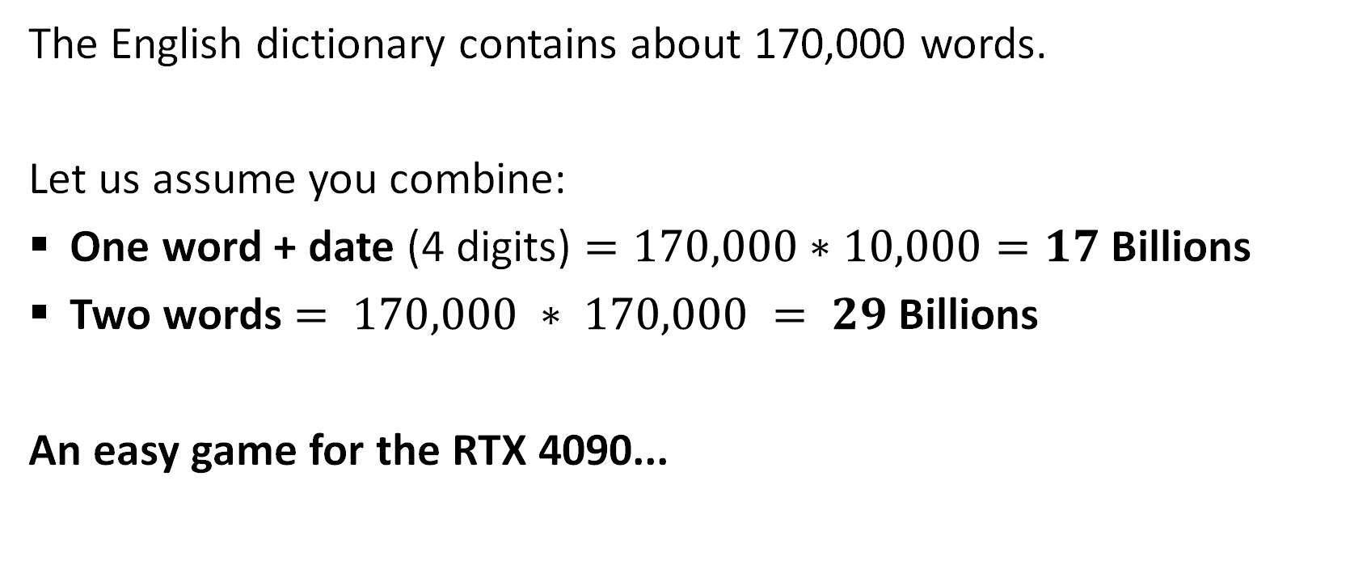
Base-Words Let’s count
The English dictionary contains about 170,000 words.
Let us assume you combine:
One word + date (4 digits) $=170,000∗10,000=17$ Billions
Two words $= 170,000 ∗ 170,000 = 29$ Billions
An easy game for the RTX 4090...
5090..

Slide 21
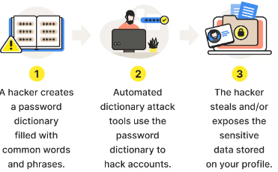
Dictionary Based Attack
The smart adversary collects the passwords from previous database leaks
and re-use them (or combine them) to increase his chances to break in

Slide 22
Authentication – Basic Principles
Can we mitigate password attacks with better authentication systems?
Knowledge factors (what you know) include all things users must know to access the system. Usernames, IDs, passwords and personal identification numbers (PINs) all fall under this category.
Possession factors (what you have) consist of anything users must have in their possession to log in. This category includes one-time password tokens, key fobs, smartphone apps, and employee ID cards.
Inherence factors (what you are) include characteristics inherent to individuals that confirm their identity. This category includes the scope of biometrics, such as retina scans, fingerprint scans, facial recognition and Voice authentication.

Slide 23
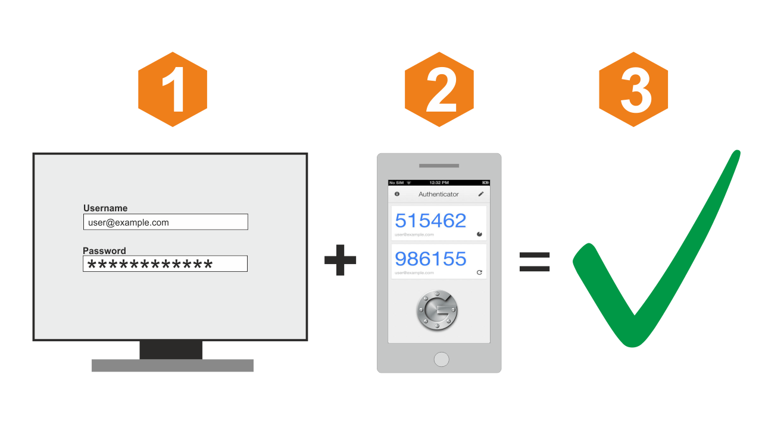
Two Factor Authentication
The user is granted the access to a system only after presenting different evidences that authenticate himself
Standard two factor authentication systems rely on:
Password
Mobile phone (SMS/email)

Slide 24
Two Factor Authentication
Standard two factor authentication systems rely on:
Password
Mobile phone SMS/email
Login is performed by:
Entering the secret password
Entering a PIN sent to the user’s SMS
The adversary has to:
Compromise the password
Steal your mobile-phone

Slide 25

Break Time…
Be back in 10 min

Slide 26
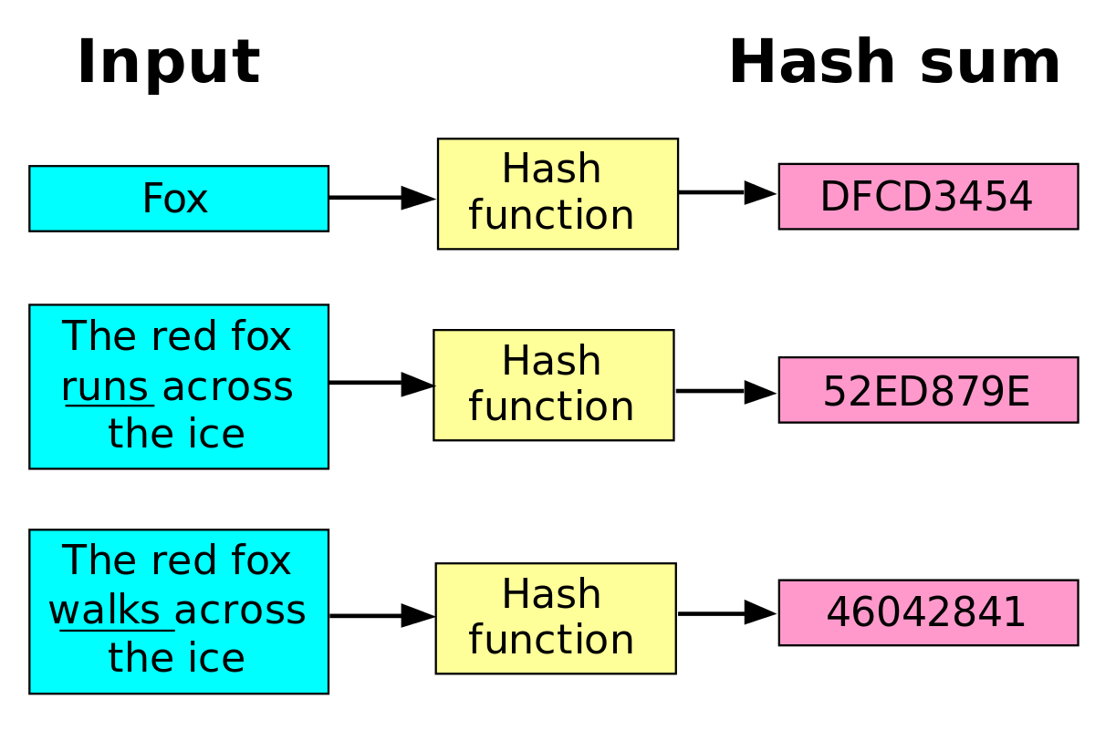
Introduction to Hash Functions
A hash function is a function used to map data of arbitrary size to data of a fixed size.
Example of hashing functions are: MD5, RIPEMD-160, SHA-1, SHA-2, SHA-3

Slide 27
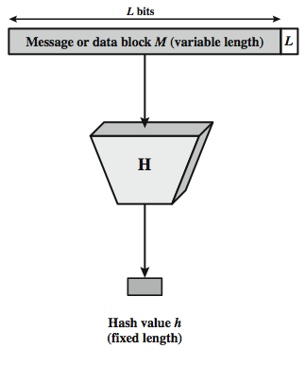
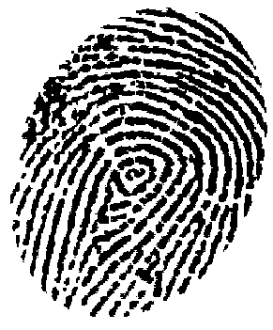
Introduction to Hash Functions
The hash value represents concisely the longer message
may called the message digest
A message digest is as a ``digital fingerprint'' of the original document
condenses arbitrary message to fixed size
h = H(M)

Slide 28
Hashing V.S. Encryption
Hello, world.
A sample sentence to show encryption.
k
E
NhbXBsZSBzZW50ZW5jZSB0byBzaG93IEVuY3J5cHRpb24KsZSBzZ
Hello, world.
A sample sentence to show encryption.
D
k
NhbXBsZSBzZW50ZW5jZSB0byBzaG93IEVuY3J5cHRpb24KsZSBzZ
Encryption is two way, and requires a key to encrypt/decrypt
This is a clear text that can easily read without using the key. The sentence is longer than the text above.
h
52f21cf7c7034a20 17a21e17e061a863
Hashing is one-way. There is no 'de-hashing’

Slide 29
Hash Function Applications
Used Alone
Fingerprint -- file integrity verification, public key fingerprint
Password storage (one-way encryption)
Combined with encryption functions
Hash based Message Authentication Code (HMAC)
protects both a message's integrity and confidentiality
Digital signature
Ensuring Non-repudiation
Encrypt hash with private (signing) key and verify with public (verification) key

Slide 30
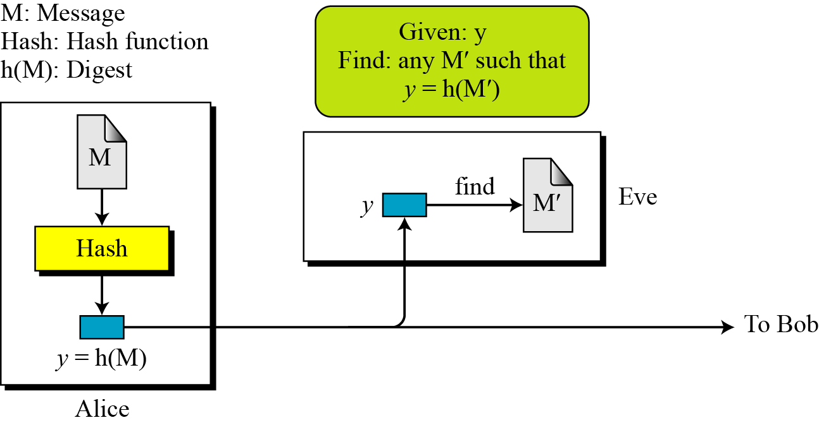
Hash Functions – Security Requirements
preimage resistant (one-way):
the hash function must be one-way
Given only a message digest, can’t find any message (or preimage) that generates that digest.

Slide 31
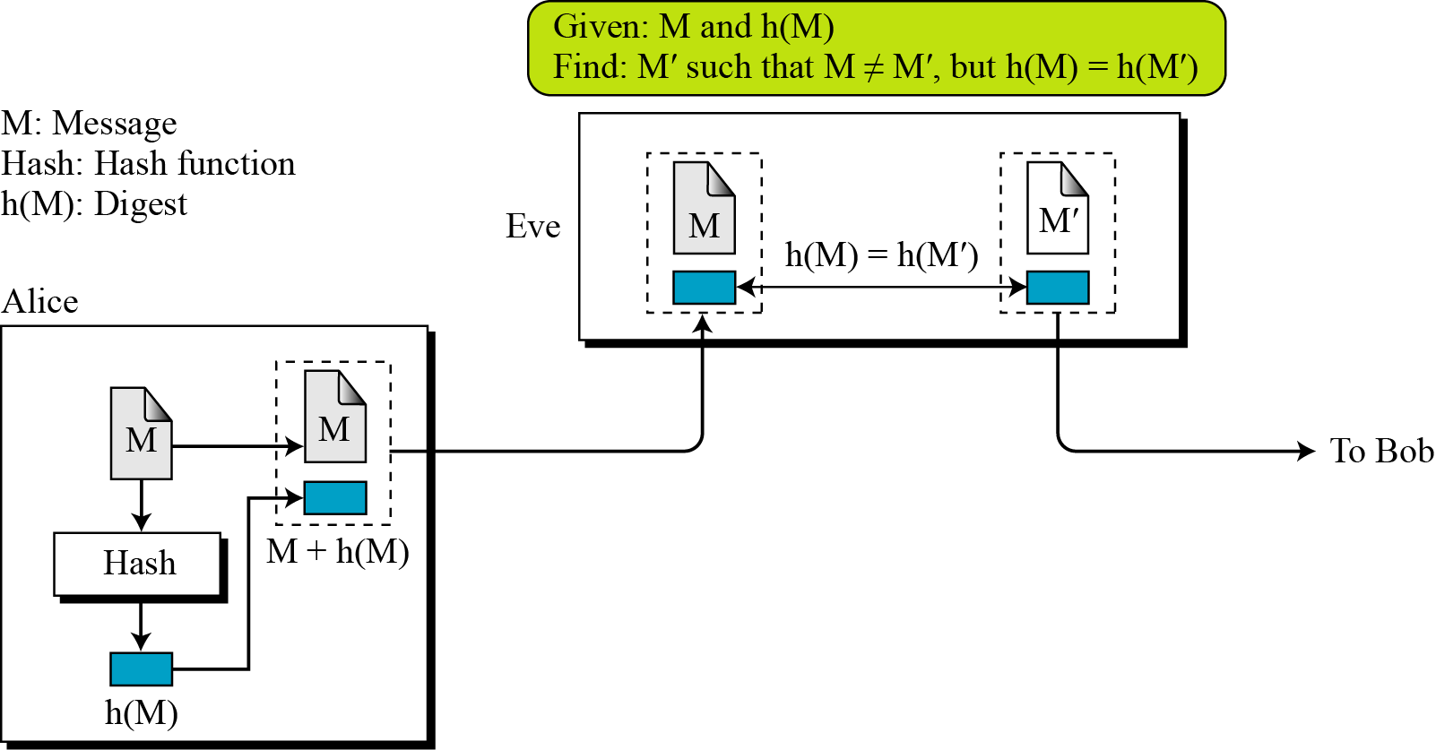
Hash Functions – Security Requirements
2-nd preimage resistant (weak collision resistant):
Given one message, can’t find another message that has the same message digest.

Slide 32
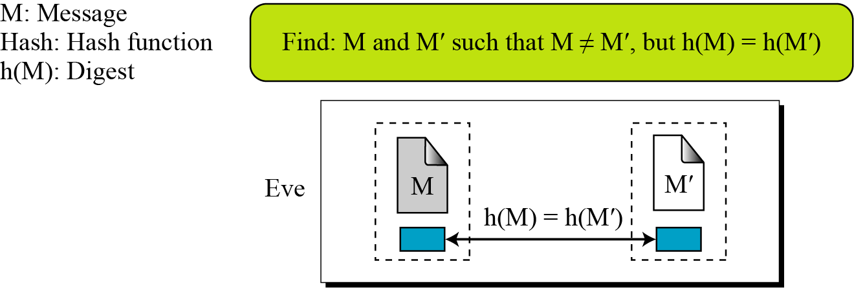
Hash Functions – Security Requirements
Collision resistant (strong collision resistant):
Can’t find any two different messages with the same message digest

Slide 33
Well Known Hash Functions
MD5
output 128 bits
collision resistance completely broken by researchers in China in 2004
SHA1
output 160 bits
no collision found yet, but method exist to find collisions in less than 2^80
considered insecure for collision resistance
one-wayness still holds
"md5 and sha1 are both clearly broken (in terms of collision-resistance)”.
Ron Rivest

Slide 34
Well Known Hash Functions
SHA2 (SHA-224, SHA-256, SHA-384, SHA-512)
outputs 224, 256, 384, and 512 bits, respectively (hash length)
SHA-256 is considered one of the most secure hashing functions. Even so, it is used in most SSL certificates and even crypto transactions.
Supported by the majority of browsers we are using today
No real security concerns (so far)
SHA3 (SHA3-224, SHA3-256, SHA3-384, SHA3-512)
based on an innovative cryptographic system called Sponge System
relatively fewer implementation costs
much faster than the previous versions
Ready to replace SHA2 when needed (the NSA has not asked to start using it to replace SHA2)

Slide 35
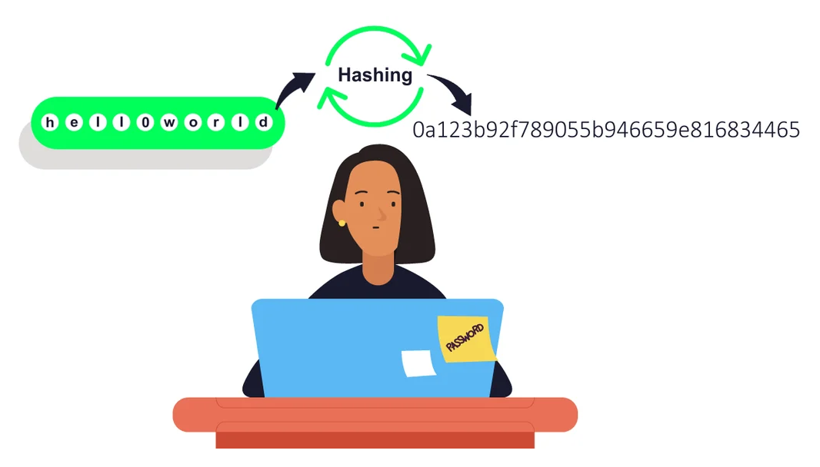
Hashing Password
Instead of user password, store hash of password
When user enters password, compute its hash and compare with entry in password file
System does not store actual passwords!

Slide 36
Hashing Password
Store Hashing Password
Verification an input password against the stored hash
Iam#4VKU
Iam#4VKU
Password store
h
h
661dce0da2bcb2d8 2884e0162acf8194
661dce0da2bcb2d8 2884e0162acf8194
661dce0da2bcb2d8 2884e0162acf8194
Hash Matching Exactly?
Password store
Yes
No
Grant
Deny

Slide 37
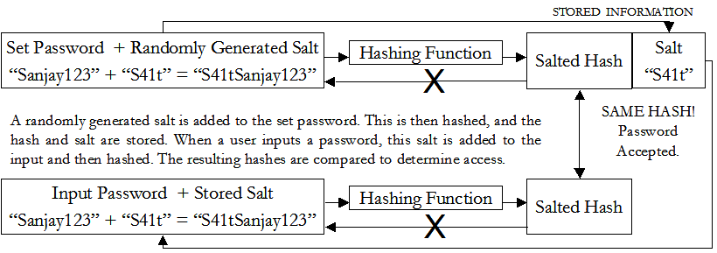
Hashing Password - Salting

Slide 38
Hashing Password – Salting Advantages
Without salt, attacker can pre-compute hashes of all dictionary words once for all password entries
Same hash function on all systems
Identical passwords hash to identical values; one table of hash values can be used for all password files
With salt, attacker must compute hashes of all dictionary words once for each password entry
With 12-bit random salt, same password can hash to 212 different hash values
Attacker must try all dictionary words for each salt value in the password file

Slide 39
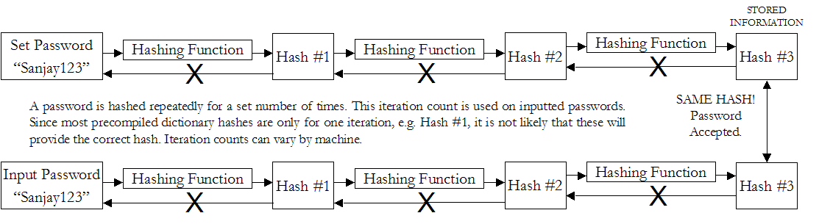
Hashing Password – Iteration Count
The same password can be rehashed many times over to make it more difficult for the hacker to crack the password.
This means that the precompiled dictionary hashes are not useful since the iteration count is different for different systems

Slide 40

Do you have any questions?

